Slide 1
Revolutionizing Patient Care: Exploring Hospital at Home Successes, Challenges, and Future Opportunities
January 18, 2024
Notes:
Hello! Welcome to today’s Panel Discussion: Revolutionizing Patient Care: Exploring Hospital at Home Successes, Challenges, and Future Opportunities

Slide 2





Vision
Mission
To realize the full health
potential of every human, everywhere.
Reform the global health ecosystem through the power of information and technology.

Slide 3
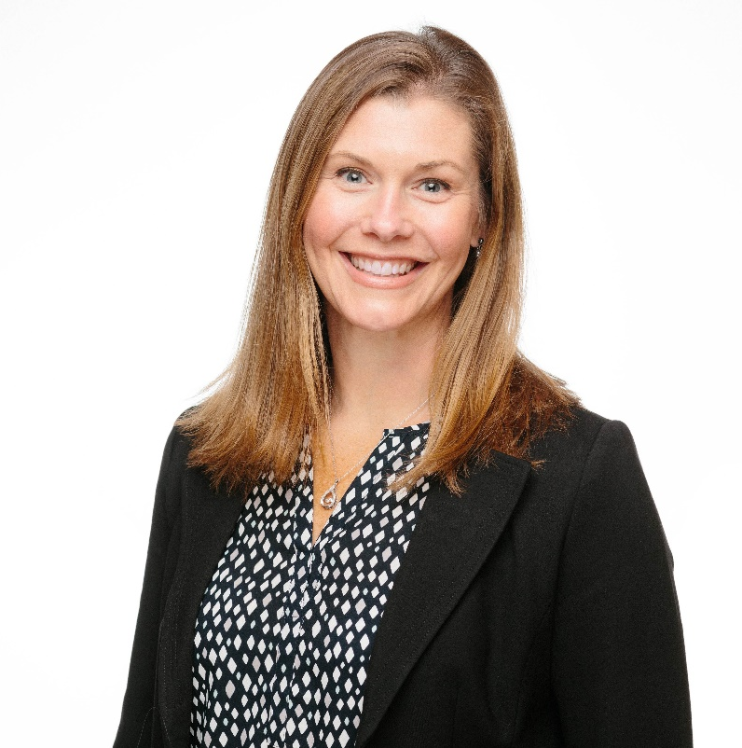
Welcome
Gwynne Jelbaoui
Program Manager
Clinical Informatics HIMSS
Gwynne.Jelbaoui@himss.org

Slide 4






Opportunities
https://www.himss.org/membership-participation/physician-community
Education
Community
Present webinars on topics such as: telehealth, medical informatics, AI, Interoperability, and best use of EHR systems
Volunteer and show leadership through CMIO Roundtable and Workgroups
Thought Leadership
Public Policy
Physician Community
Gain insight into current policy updates and affect change in healthcare systems and planning
Physician Executive subject matter expertise; Interview with HIMSS Media; contribute to preconference forum planning
Education Task Force
Drive education and content for the community
Physician Resources
Access career profiles, education, articles, and news items
Strategic Partners
Collaborate with high profile Physician Societies such as AMDIS, EHRA, and AMIA

Slide 5
Revolutionizing Patient Care: Exploring Hospital at Home Successes, Challenges, and Future Opportunities
Learning Objectives:
Obtain a clear understanding of the benefits, challenges, and solutions that are part of implementing a hospital at home program.
Understand the key technical solutions and interoperability considerations for a successful hospital at home program.
Receive insight on the future of hospital at home programs and regulatory factors that need to be top of mind.
Deduce the importance of patient education and engagement.

Slide 6
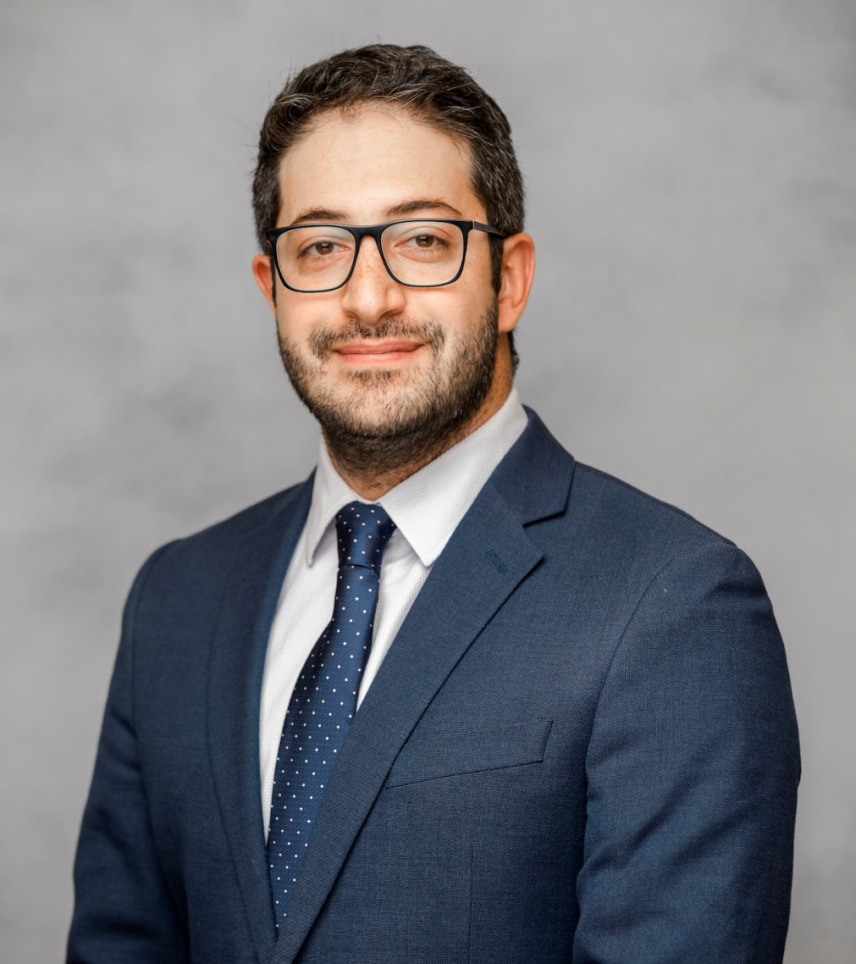
Moderator
Anwar Jebran, MD
Primary Care Physician Informaticist at Oak Street Health, and Clinical Assistant Professor at The University of Illinois Chicago.
HIMSS Physician Committee member

Slide 7
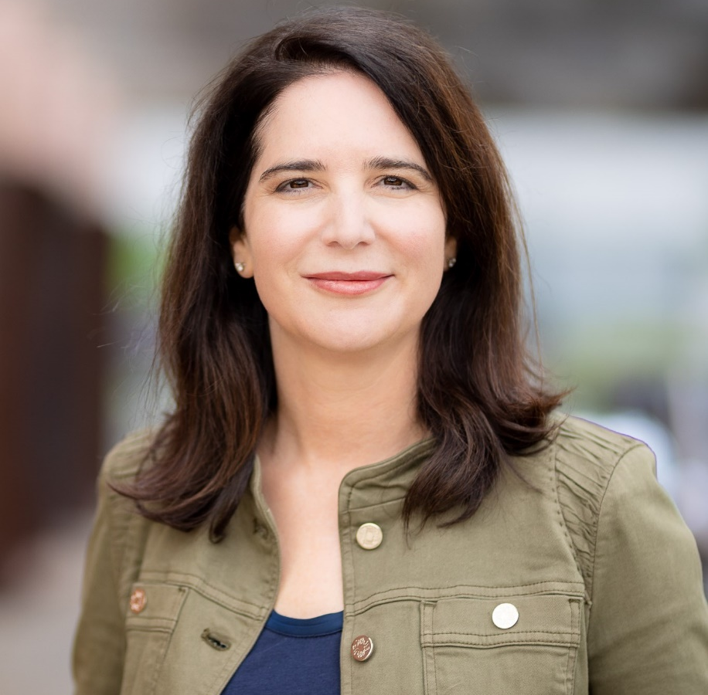
Eve Cunningham, MD, MBA
Head of Virtual Care and Digital Health at Providence
As Providence's Group VP and Chief of Virtual Care and Digital Health, Dr. Cunningham leads a team of 100+ caregivers and 250 providers that offer a care delivery portfolio including 9 enterprise virtual care service lines, hospital-at-home, remote patient monitoring, a virtual nursing team, virtual behavioral health platform, and the MedPearl a digital assistant. Her team has launched virtual care services to 100 + sites across 8 states.
She is board certified in Obstetrics and Gynecology. Passionate about healthcare tech and transformation, she excels in clinical informatics, applied technologies and clinical operations. Dr. Cunningham earned her medical degree from Saint Louis University and MBA from University of Massachusetts.
Dr. Cunningham is also in her second year on the HIMSS Physician Committee.

Slide 8
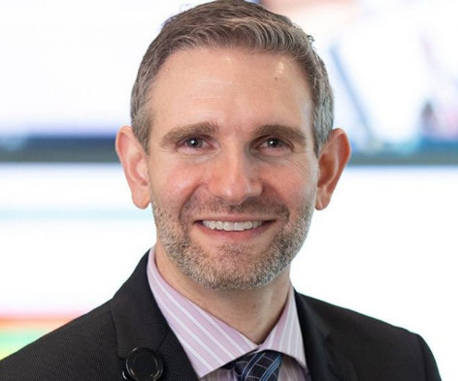
Michael Maniaci, MD
Enterprise Medical Director of Care Anyplace at Mayo Clinic Center for Digital Health; Medical Director of Mayo Clinic Hospital Florida
Michael J. Maniaci, M.D. is the Enterprise Medical Director of Care Anyplace in the Mayo Clinic Center for Digital Health, the Enterprise Physician Lead for the Advanced Care at Home program, and the current Medical Director of Mayo Clinic Hospital in Florida.
He received his M.D. from Saint Louis University Medical School in 2003. He completed his residency training at the Mayo Graduate School of Medicine in 2006 and is boarded in Internal Medicine.
Dr. Maniaci has a passion for innovation and technology in the medical field. He is recognized as leader in faculty development for the teaching of simulation medicine and has had several invited professorships to teach faculty development in simulation both in United States and throughout Asia. His current focus is developing the Advanced Care at Home program and the Care Hotel program, Mayo Clinic’s first expansion into the virtual home hospital and surgical aftercare realm.

Slide 9
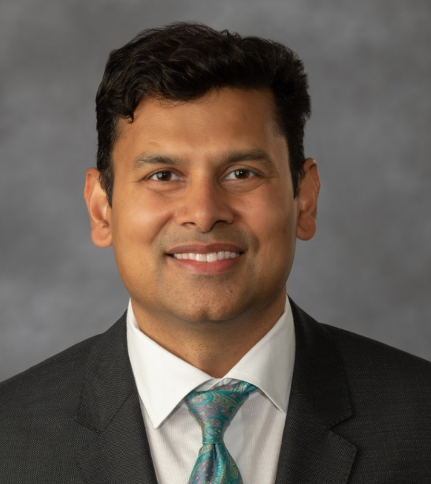
Vimal Mishra, MD
Assoc. Chief Medical Officer at UC Davis Health; and Director of Digital Health at AMA
Dr. Vimal Mishra serves as an Associate Chief Medical Officer at UC Davis Health. He provides executive leadership in the development and orchestration of transformative healthcare, focusing on innovations in clinical practices, digital strategies, and business models.
In his executive roles at various organizations, Dr. Mishra has spearheaded large-scale clinical and digital transformations. He has launched key initiatives such as hospital-at-home, care at home, and virtual healthcare, as well as programs aimed at improving clinical access, capacity, and throughput. All of these have significantly impacted healthcare. His contributions have notably advanced the science and practice of digital health, including the development of new care delivery resources and the promotion of initiatives like the Physician Innovation Network.
An award-winning physician, Dr. Mishra is known for his clinical leadership and expertise in informatics. His influential work, including publications like "Return on Health" and "Health at Home," has spurred discussions on digitally enabled care and its impact. A consistent “Top Doctor” in Richmond, Virginia, he is actively involved in healthcare improvement through speaking and various advisory roles. His commitment to healthcare innovation and excellence is matched by his board certifications in Internal Medicine and Clinical Informatics and his Duke University School of Business education.
Dr. Mishra just completed his two years of service on the HIMSS Physician Committee

Slide 10
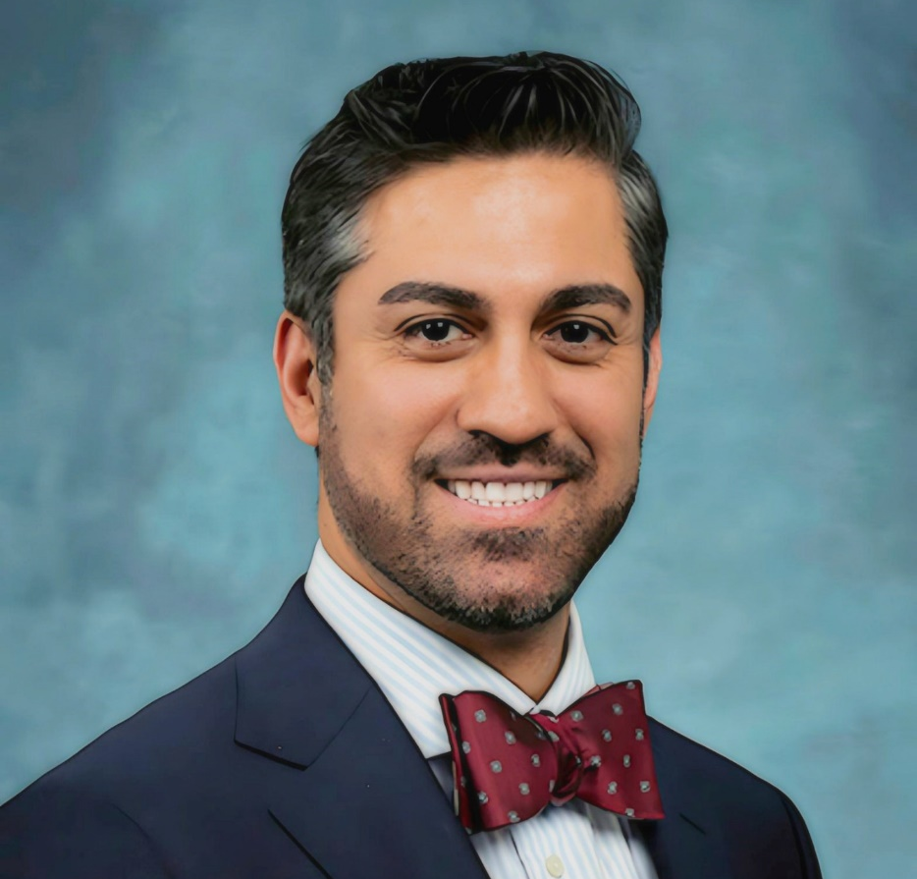
R. Ryan Sadeghian, MD, MBA, MSc
Principal Healthcare Strategist at MITConn Consulting
Dr. R. Ryan Sadeghian is a seasoned Physician Informatician, with strong background in Clinical and Biomedical Informatics. With over 15 years of healthcare leadership experience, he has been instrumental in implementing digital transformation initiatives, optimizing system workflows, and enhancing EMR systems.
Dr. Sadeghian’s dedication to improving healthcare value, quality, and safety, coupled with his commitment to reducing physician burnout and increasing access to care in underserved areas, underscores his impactful contributions to the field.
Dr. Sadeghian is also in his second year on the HIMSS Physician Committee

Slide 11


Panel Discussion

Slide 12
Questions from the attendees?

Slide 13
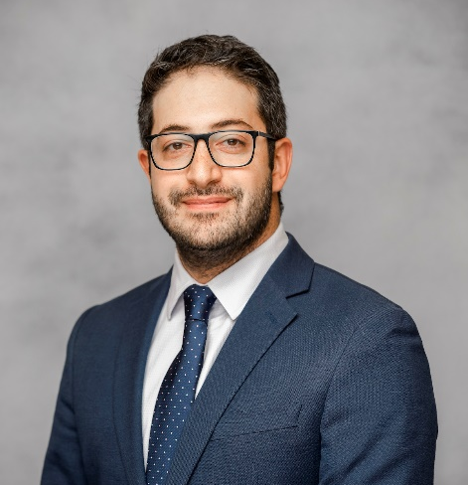







Thank you, Speakers!!
Anwar Jebran, MD
Moderator
Primary Care Physician Informaticist at Oak Street Health; and Clinical Assistant Professor at The University of Illinois Chicago
Eve Cunningham, MD, MBA
Head of Virtual Care and Digital Health at Providence
Michael Maniaci, MD
Internal Medicine, Hospital
Medicine
Enterprise Medical Director; Enterprise Physician Lead; and Medical Director at Mayo Clinic Hospital, FL
Vimal Mishra, MD
Assoc. Chief Medical Officer at UC Davis Health; and Director of Digital Health at AMA
R. Ryan Sadeghian, MD, MBA, MSc
Consulting Chief Health Information Officer at
MITConn

Slide 14


Thank you!
Contact emails:
Physician Community informatics@himss.org
Gwynne Jelbaoui
Gwynne.Jelbaoui@himss.org

