Slide 1
Insights from the 2022 HIMSS Nursing Informatics Workforce Survey: Exploring the Current State and Future of Nursing Informatics
HIMSS Nursing Informatics Community Webinar
May 17, 2023

Slide 2

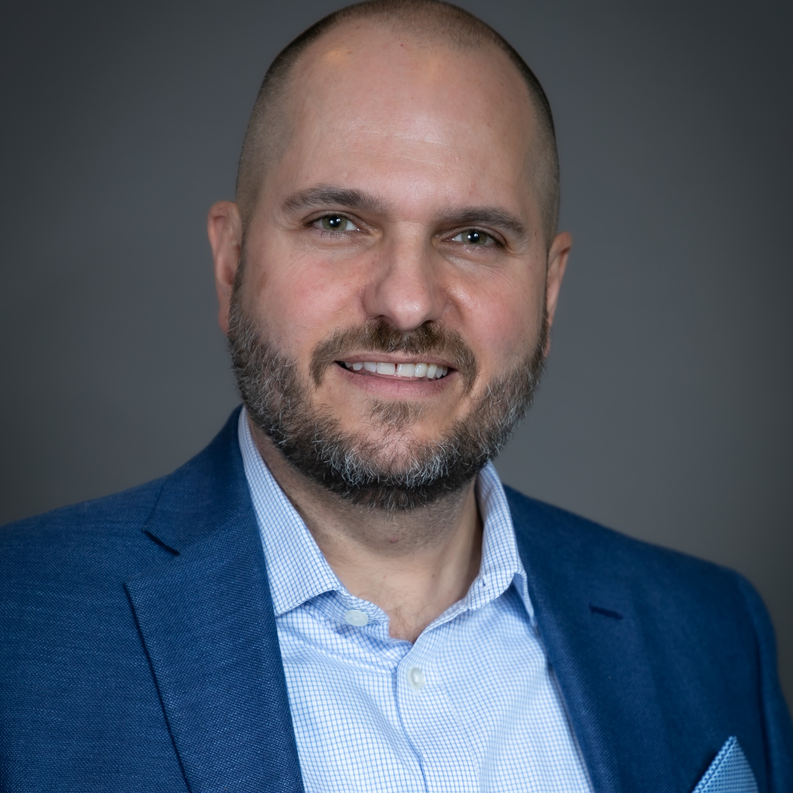

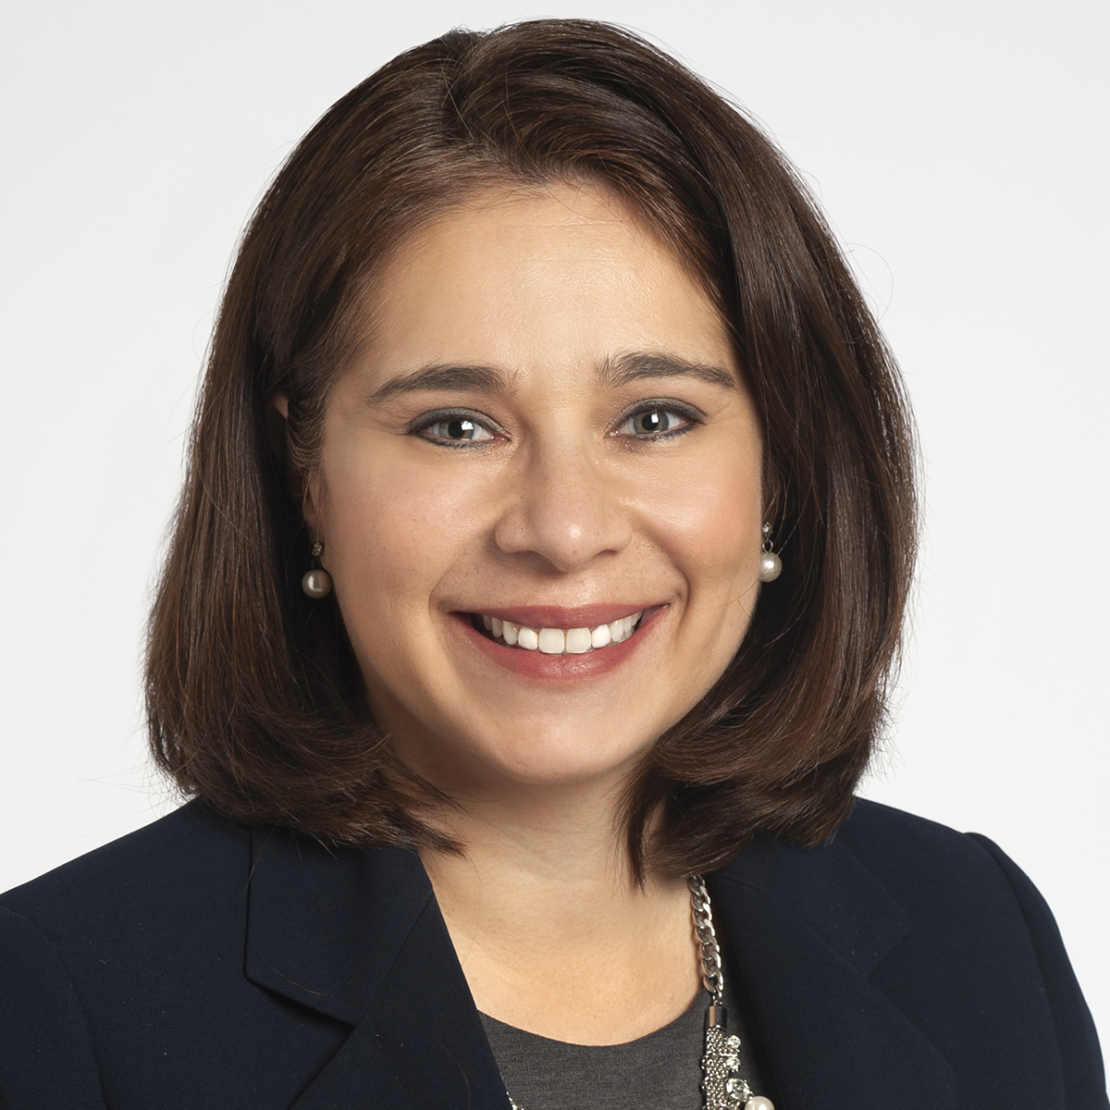
Insights from the 2023 HIMSS Nursing Informatics Workforce Survey: Exploring the Current State and Future of Nursing Informatics
HIMSS Nursing Informatics Community Webinar | May 17
Chad B Carroll, DNP, RN-BC
Whende M. Carroll, MSN, RN-BC, FHIMSS​
Nelita Iuppa, DNP, MS, BSN, RN-BC,
NEA-BC, FHIMSS
Health Informaticist
Northwestern Medicine
Clinical Informatics Advisor, HIMSS​
Associate Chief Nursing Informatics Officer, Cleveland Clinic

Slide 3


Welcome
Cait Obenauf, MBA
Program Manager, Clinical Informatics, HIMSS

Slide 4


Organization Logo

Slide 5







Join the HIMSS Nursing Informatics Community
Apply for the HIMSS Nursing Informatics Committee
https://www.himss.org/membership-participation/nursing-informatics-community
https://www.himss.org/membership-participation/nursing-informatics-committee
Ways to get involved at HIMSS
as an informatics nurse
Submit a manuscript to the Online Journal of Nursing Informatics
Join the HIMSS Nursing Informatics Education & Networking Task Force
https://www.himss.org/resources/online-journal-nursing-informatics
Reach out to Cait Michicich at cait.michicich@himss.org
Attend an upcoming webinar or coffee chat
Get involved with your local HIMSS Chapter
https://www.himss.org/events
https://www.himss.org/membership-participation-chapters

Slide 6
Agenda
Meet the Speakers
Learning Objectives
Background of the HIMSS Nursing Informatics Workforce Survey
NI Workforce Survey Findings & Key Takeaways
What does this mean for the future?
Wrap-up and Q&A

Slide 7
Meet the Speakers
Chad B. Carroll, DNP, MS, RN-BC
Whende M. Carroll, MSN, RN-BC, FHIMSS​
Nelita Iuppa, DNP, MS, BSN, RN-BC,
NEA-BC, FHIMSS
Health Informaticist
Northwestern Medicine
Clinical Informatics Advisor, HIMSS​
Associate Chief Nursing Officer, Cleveland Clinic

Slide 8
Learning Objectives
Illustrate value of nursing informatics by using nursing informatics workforce trends from the 2022 HIMSS Nursing Informatics Workforce Survey
Describe the various functions and responsibilities of nurse informaticists (NI) in healthcare settings
Describe the setting, roles, education, certification, and other metrics related to the nursing informatics workforce

Slide 9
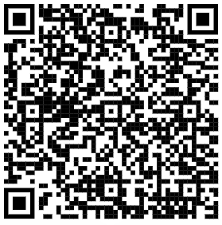
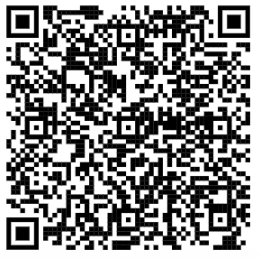
QR Codes to Reports
2023 HIMSS Nursing Informatics Workforce Survey
Nursing Informatics Workforce Salary and Benefits Report

Slide 10



Background & Overview

Slide 11



HIMSS Nursing Informatics Workforce Survey
Methodology
Development
HIMSS NI Committee, HIMSS Staff reviewed and formulated questions. To reflect current workforce and industry trends, new questions and response options were added
Analysis, Review, Publication
HIMSS Staff and HIMSS NI Committee conducted analysis, and review. An Executive Summary, Salary Guide and Full Report are posted on HIMSS.org
Distribution
Online survey was used Oct-Nov 2022; invitations sent by HIMSS, and organizations that sponsored and supported this research (ANI, ANIA, AORN, AMIA-NYWG, NCNA, NENIC, AANP)
2022 Survey Closed with n=1,118 Valid Responses
2020 survey n=1,359 responses
2017 survey n=1,279 responses
2014 survey n=1,047 responses
Notes:
Since 2004, HIMSS has surveyed the nursing informatics community to better understand the functions, responsibilities, and compensation related to this role.
In Nov and Dec of 2022, a total of 1,228 valid respondents provided information about their current positions and their career trajectories, xxx. This is not the exact survey from 2004 as we have adjusted the questions based on the continued growth and changes in the workforce. Members of HIMSS Market Insights team were engaged to ensure the survey integrity, format and structure captures the accurate information and provides the relevant analysis to support the research process.
The survey was distributed to HIMSS members and HIMSS collaborators listed here and we thank them for their support.

Slide 12
Nursing Informatics Workforce Survey Overview
As with previous years, an online survey was used to collect this data. Nurse informaticists were invited to participate during October and November of 2022. Invitations were sent by HIMSS and by organizations that sponsored and supported this research. These organizations include:
  Alliance for Nursing Informatics, American Nursing Informatics Association, American Medical Informatics Association Nursing Informatics Working Group, North Carolina Nurses Association Council on Nursing Informatics, New England Nursing Informatics Consortium, Association of periOperative Registered Nurses, American Association of Nurse Practitioners
This research was sponsored by Fresenius Kabi in 2022.
    Fresenius Kabi was not identified as a sponsor to the respondents that completed the survey.
1,118 nursing informaticists provided responses during this data collection period.
  The 2020 survey received 1,359 responses, 2017 survey received 1,279 responses and the 2014 survey received 1,047 responses.
To reflect current workforce trends, new questions and response options were added in 2022.
This report includes a written executive summary and detailed information about nurse informaticists’ functions, responsibilities, and compensation.

Slide 13
Executive Summary
% based on survey respondents
1
Workplace
Title, Education, Training
3
Salary and Satisfaction
2
62% work for a hospital or multi-facility health system.
5% were international respondents.
Reporting structures are shifting with Information Systems/Technology (34%), Informatics (33%) and Nursing (30%) being the most common. On average, nurse informaticists are reporting into two departments.
Reporting structures are shifting with Information Systems/Technology (34%), Informatics (33%) and Nursing (30%) being the most common. On average, nurse informaticists are reporting into two departments.
60% stated they earn a base annual salary of $100,000 or more.
Over time, respondents have remained satisfied with their choice of career in informatics (76% highly satisfied), although a quarter feel the Nursing Informatics role is not at all valued by their organization.

Slide 14
Nurse Informaticists Overview

Slide 15
Job Title
A VARIETY OF JOB TITLES ARE USED
Nursing Informatics Specialist (17%) remains as the most common title. Followed by Clinical Informatics Specialist (12%) now becoming more popular.
Titles under 4% incidence, not shown
Notes:
Q2

Slide 16
Job Responsibilities
TOP 5 RESPONSIBILITIES
REMAIN CONSISTENT
Systems Implementation (41%), System Optimization/Utilization (35%), Project Management (30%), Systems Development (29%), and Quality Initiatives/Reporting (26%) are the top five job responsibilities for nurse informaticists.
Job responsibilities under 20% incidence, not shown
Respondents were asked to select up to their top 5 responsibilities
*New options beginning in 2020
Notes:
Q39

Slide 17
Job Satisfaction in Current Position
HALF ARE HIGHLY SATISFIED
53% are highly satisfied and 43% are somewhat satisfied with their current position. Dissatisfaction has seen a slight decline.
Notes:
Q43

Slide 18
Perceived Value of Nursing Informatics
MAJORITY DO NOT FEEL VALUED
Nearly a quarter do not believe their organization perceives the nursing informatics role to be valuable. 41% feel that it is only somewhat valued.
New question in 2022
Notes:
Q44c

Slide 19
Nursing Informatics Valued For…
OVER HALF BELIEVE THEY ARE VALUED
FOR TRAINING, NURSING PRACTICE SUPPORT/REDESIGN
NI expertise is valued most often for Training, nursing practice support /redesign (53%), Applying data to support clinical care (42%) and System design (38%).
‘Unsure/Don’t know 5% ‘None of the above’ 3%, not shown
New question in 2022
Notes:
Q44d
Shown to everyone

Slide 20
Satisfaction with Informatics Career Choice
CAREER SATISFICATION REMAINS HIGH
3-in-4 are highly satisfied with their career choice in informatics, while nearly a quarter are somewhat satisfied.
Notes:
Q44
No stat testing to call out

Slide 21
Key Takeaways
Nursing Informatics Specialist remains the most common job title
System Development & Implementation are the most prevalent job responsibilities
Job Satisfaction very high
Perceived Value is low

Slide 22
Focus:
Compensation

Slide 23
U.S. Salary
SALARIES ARE INCREASING
In 2022, 60% of nurse informaticists report a salary greater than $100,000. This is up from 49% in 2020, 45% in 2017 and 33% in 2014.
‘Prefer not to answer’ 2%, not shown
Notes:
Q33: Income breaks changed within this years survey
N=1071

Slide 24
Salary by Education Level
2022 Results
HIGHER EDUCATION MOST OFTEN
COMES WITH A HIGHER SALARY
Nurse informaticists with higher levels of formal education most often tend to have higher salaries– 25% of PhD or an equivalent degree have a salary over $176,000, compared to 8%-12% of all other degrees.
Notes:
Q33 & Q11

Slide 25
Salary by Years of NI Experience
2022 Results
MORE TENURE EQUALS A HIGHER SALARY
Nurse informaticists with more experience tend to have higher salaries. 42% with 16 or more years of experience have a salary greater than $150,000, compared with only 6% of those with less than 5 years of experience.
Notes:
Q35

Slide 26
Salary by Certification Type
2022 Results
CERTIFICATION MAY HAVE
SALARY BENEFITS
Nurse informaticists who hold an Informatics Related Certification(s) have higher salaries compared to those with no certifications.
‘Informatics Related Certifications’ is a combination of RN-BC, HIMSS Certifications (CPHIMS/CAHIMS/CPDHST), AHIC and CHTS
Notes:
Q33 salary (n=1,071) & Q17
RN-BC n=426
Could also even throw in that 50% that hold a HIMSS cert. of some sort have a salary of >$125k.

Slide 27
Key Takeaways
Salaries continue to rise
60% report making more than $100,000
Higher Education/Increased Experience typically results in higher salary

Slide 28
Education and Certification

Slide 29
Nursing Education
ADVANCED DEGREES SHIFTING SLIGHTLY
40% report having a Bachelor’s in Nursing, followed by 28% with a Master’s in Nursing Informatics and 19% with a Master’s in Nursing.
63% have any Master’s degree in 2022, varying slightly with 66% in 2020, 64% in 2017 and 59% in 2014.
Answer choices <6% incidence, not shown
*New options beginning in 2017
Notes:
Q11 – select all that apply

Slide 30
Years of Clinical Experience
FEWER YEARS OF CLINICAL EXPERIENCE
Only 15% of nurse informaticists have more than 20 years of clinical experience, compared to 28% in 2014.
Notes:
Q14
21-25 yrs: 8%
26-30 yrs: 5%
30+ yrs: 2%

Slide 31
Years of Informatics Experience
NURSING INFORMATICS FIELD IS
WELL ESTABLISHED
39% of nurse informaticists now have more than 10 years of experience in informatics.
Notes:
Q35 – different breaks in previous years.

Slide 32
Years in Current Role
TENURE IN ROLES
CONTINUES TO INCREASE
In 2022, 44% have been in their current role for longer than 5 years, this is an increase from 24% in 2014.
Notes:
Q36

Slide 33
Perceived Value in Holding Certification
CERTIFICATION VALUES ARE CONSISTENT
As seen in prior years, personal satisfaction (60%), credibility (55%), and validation of specialized knowledge (54%) are the top three values seen in certification.
On average, each respondent selected 4.6 values.
Answer choices <30% incidence and ‘Other’ 2%, not shown
Notes:
Q20; n=779 overall that answered this question (“there is no value 0%)

Slide 34
Impact of Certification on Career Path
CERTIFICATION IS IMPACTFUL,
ALTHOUGH PERCEIVED VALUE
HAS DECREASED SLIGHTLY
41% report that achieving certification has been highly impactful on their career in 2022, with 21% now feeling it is not impactful.
Notes:
Q21

Slide 35
New Role Post Certification?
NEARLY 6-IN-10 HAVE A NEW ROLE
POST CERTIFICATION
Among those with a certification, 58% have moved to a new role since becoming certified, increasing from 41% in 2020.
Notes:
Q18
N=779 for 2022; n=783 for 2020 and n=619 for 2017

Slide 36
Timeframe of Role Change After Certification
NEW ROLES COME QUICKLY
57% are in a new role within a year after certification. Another 20%, are in a new role in 13-18 months.
Notes:
Q19

Slide 37
Informatics Training/Education
In-Process
INCREASE IN MASTERS/PhD ENROLLMENT
14% are currently enrolled in a Master’s/PhD/DNP program, while13% are doing On-the-job training or a Program/Course.
‘Other’ 4% and ‘not currently enrolled’ 54% for 2022, not shown
*New option beginning in 2020
Notes:
Q13_org – currently enrolled
1.22 programs enrolled in on average for 2022

Slide 38
Sources of Continuing Education & Professional Development
SOURCES ARE SHIFTING
Professional organizations (57%), Programs offered by employers (42%) and Websites (41%) were the top three go-to places for continuing education and professional development. On average, each respondent selected 3.8 sources in 2022.
Notes:
Q25
2022: On average, 3.77 items were selected. 2020: On average, 5.43 items were selected.

Slide 39
Fewer years of clinical experience, with more years within the informatics specialty and in current roles as informaticists
Personal satisfaction remains the reason for obtaining a certification, with slight decrease in perceived certifications value
Informatics nurses are shifting away from national conferences to more web-based and social media for continuous learning
Key Highlights

Slide 40
Job Details and Future Forward

Slide 41
Applications Developing, Implementing, or Optimizing
APPLICATIONS ARE EVER-CHANGING
Nurse informaticists are working with EMR/EHR (58%) and Clinical documentation systems (53%) most often. Nurse informaticists are also working increasingly with System integration (31%), Mobile Tech (28%) and Medical Device Integration (24%).
Answer choices <25% incidence, ‘Other’ 3% & ‘None” 4%, not shown
*New option beginning in 2020
Notes:
Q41

Slide 42
Applications
Used
EHR AND CLINICAL DOCUMENTATION
SYSTEMS USED MOST OFTEN
EHR/EMR (58%), Clinical documentation systems (53%) and Clinical decision support systems (37%) are the three applications being utilized on a regular basis.
Answer choices <20% incidence; ‘Other’ 3% and ’None of the above’ 4%, not shown
Respondents were asked to select up to their top 5 applications used regularly
New question in 2022
Notes:
Q42

Slide 43
Transforming Care Models
A VARIETY OF TECHNOLOGIES
ARE BEING LEVERAGED
Top technologies being used to transform care models, specific to nursing: Analytical and business intelligence data for reporting outcomes (38%), Ensuring nurses have a mobile device (36%) and Telenursing visits/care (34%).
New question in 2022
‘Other’ 2% & ‘None of the above 12%, not shown
Notes:
Q42a

Slide 44
Interests In Learning More
CLINICAL INFORMATICS/ANALYTICS
Clinical informatics (41%), Clinical analytics (33%) and Nursing informatics as a professional discipline (29%) were the top areas nurse informaticists want to learn more about.
‘Other’ 2%, not shown
Respondents were asked to select up to the 5 top areas
Notes:
Q46_org

Slide 45
Key Highlights
Technology applications used are more digital health-focused including smart phones, wearables, and virtual health
New care models are being leveraged to deliver care – virtual/remote, intelligent, and interoperable
Nurses are curious in learning more about emerging technologies, innovation, digital health and interoperability

Slide 46
Focus:
Nursing Informatics Workplaces

Slide 47
Primary Workplace
WORKPLACE REMAINS CONSISTENT
Hospitals and health systems (62%) remain the most common primary workplace for nurse informaticists.
Worksites under 3% incidence, not shown
Notes:
Q3

Slide 48
Magnet Status
MAGNET STATUS CONTINUES TO BE MORE COMMON
Over 6-in-10 work in health systems with at least one hospital designated with Magnet Status, increasing by 24% since 2014.
Notes:
Q5

Slide 49
Geographic Region
REPRESENTATION ACROSS THE U.S.,
WITH A BLEND OF NON-U.S.
Distribution of nurse informaticists across the United States in 2022: South (32%), Midwest (20%), West (23%) and Northeast (20%). 5% also included from outside of the U.S.

Slide 50

Workplaces
  #1 Hospitals & Health Systems
  Up and Coming Vendor & Payers
Magnet
  Leverage this professional network for Informatics support, advocacy, sharing, and growth
Geographic Region
  Growth since last survey in West & Northeast Regions
  Possible decline in South, Midwest, and International (or fewer participants) from those markets in 2022

Slide 51
Focus:
Organizational Structure

Slide 52
Department Reporting Structure
REPORTING STRUCTURES ARE SHIFTING
Nurse informaticists are now reporting into a variety of departments, with reporting into two departments on average. The top 3 departments are IS/IT (34%), Informatics (33%) and Nursing (30%).
Answer choices <8% incidence & ‘Other’ 4%, not shown
**New option in 2022; *New option in 2020
Notes:
Q27
2.04 depts per person on avg.

Slide 53
Nursing Informatics Staffing: Over the past 3 years
NURSING INFORMATICS POSITIONS
ARE INCREASING
Over a third reported that the number of nursing informatics positions have increased, over the past three years. 21% also stated that their organization is redefining the roles/responsibilities of current positions and/or creating more.
New question in 2022
Notes:
Q32a

Slide 54
Chief Nursing Informatics Officer at Organization
NEARLY HALF HAVE A CNIO
54% of nurse informaticists work in organizations which have a CNIO or other senior nursing informatics officer.
*New option beginning in 2020
Notes:
Q29
N=1,118

Slide 55
Reporting Structure for CNIO
REPORTING STRUCTURES ARE
SHIFTING SLIGHTLY
The reporting structure for CNIOs vary, with the titles of CNO/Nursing Executive (27%), CIO/IT Executive (27%) and CMO/CMIO/Physician Executive (21%) being reported into most often.
*New option beginning in 2020
Notes:
(21%).
Q30
N=541

Slide 56

Reporting Structure
  Placement is critical for maximum influence and value
NI Staffing
  Need to grow this workforce to support digital transformation
CNIO Role
  Partnership collaboration opportunities with CMIO
  Evolving job description and responsibilities
  Often parallels reporting structure in terms of organizational impact & merit

Slide 57

Key Takeaways

Slide 58

2022 Nursing Informatics Workforce Survey
Executive Summary
Salary Guide
Results Slide Deck
ADDITIONAL RESOURCES AVAILABLE/FORTHCOMING
Infographic
HIMSS Nursing Informatics Workforce Survey. (2022). ©Healthcare Information and Management Systems Society. Retrieved from http://himss.org/ni
Webinar Presentation
Notes:
Can update link when live

Slide 59
Questions?

Slide 60





Thank you
For more information, please contact:
Cait Obenauf, MBA
Program Manager, HIMSS
Cait.Obenauf@himss.org

Slide 61
Appendix

Slide 62
U.S. Salary
SALARIES ARE INCREASING
In 2020, 49% of nurse informaticists report a salary greater than $100,000. This is up from 45% in 2017 and 33% in 2014.
‘Prefer not to answer’ 2%, not shown
Notes:
Old slide from 2020: Different salary breaks shown in 2014-2020 vs 2022

Slide 63
Time Spent on Clinical Care
OVER 6-IN-10 DO NOT PARTICIPATE IN CLINICAL CARE
A THIRD ARE INVOLVED IN DIRECT PATIENT CARE
Clinical care is increasing slightly, although 65% do not spend work time in clinical care.
Among those that perform patient care activities, 65% either assist with or take direct care patient assignments. 1-in-5 only support administrative tasks.
Notes:
Q16
Note this data was only shown to respondents who indicated that they spent at least some time on clinical care (i.e. the slide before). Is this stated clearly enough? I had to go back and check to make sure I understood. The change in terminology tripped me up (slide 50 clinical care and on this slide we refer to it as patient care activities).

Slide 64
Job Title and Job Responsibilities
2022 Results
NURSING INFORMATICS SPECIALISTS HAVE
A WIDE VARIETY OF RESPONSIBILITES
The most common job responsibilities are Systems Development,
Systems Implementation, System Optimization/Utilization, Quality Initiatives/Reporting and Liaison/Communicator.
Respondents were asked to select up to their top 5 responsibilities
Notes:
Q2 & Q39

Slide 65
Barriers/Challenges Preventing a Successful Career
2022 Results
48%
38%
33%
31%
TOP CHALLENGE: CAREER ADVANCEMENT
OPPORTUNITIES
25%
Lack of career advancement/promotion opportunities (48%), achieving/sustaining a work/life balance (38%) and lack of coaches, mentors or sponsors (33%) were ranked as the top challenges preventing career achievements.
23%
21%
15%
11%
New question in 2022
‘Other’ 6% & ‘None of the above’ 9%, not shown
Notes:
Q45a

Slide 66
Barriers/Challenges Preventing a Successful Career
2022 Results
CAREER ADVANCEMENT ISSUES
33% of those with a PhD/DNP/Doctor degree
vs. 19%-20% of all other degrees/certifications
Nurse informaticists with a PhD/DNP/Doctor degree are significantly more likely to believe that Lack of high profile/visible projects is a barrier to a successful career. While those living in the West region are significantly more likely to believe that Lack of diversity among management is a bigger challenge.
23% amongst those living in the West region vs. 12%-14% amongst those living in other regions
Notes:
Q45a

Slide 67
Job Change in Near Future?
2022 Results
65% of employees with a low job satisfaction vs. 27% amongst those with less a moderate job satisfaction vs. 5% amongst those with a high job satisfaction
37% of those with a salary of $75k or less vs. 11%-16% all salary ranges of $76k+
JOB SATISFACTION AND SALARY
ARE MOTIVATORS
Among those that have plans to change jobs within the next year, employees with a low job satisfaction level and/or a low salary, are significantly more likely to do so.
Notes:
Q44a

Slide 68
Reasons for a
Job Change
2022 Results
65% of those living in the Midwest vs. 42% amongst those living in the Northeast or South vs. 32% amongst those living in the West
64% of employees with a low job satisfaction vs. 37% amongst those with less a moderate job satisfaction vs. 12% amongst those with a high job satisfaction
46% of those with a salary of $151k+
vs. 29% amongst those with a salary of $126-$150k
vs. 30% amongst those with a salary of $101-$125k
vs. 34% amongst those with a salary of $76-$100k
vs. 20% amongst those with a salary of $75k or less
REGION, JOB SATISFACTION AND
SALARY AFFECT EMPLOYEE NEEDS
Among those seeking a promotion/expanded role, those that live in the Midwest are significantly more likely to search for one. While those with a low job satisfaction or higher salary, are significantly more likely to report having leadership challenges.
Notes:
Q44a

Slide 69
Nursing Informatics Valued For…
2022 Results
46% amongst those who have 16+ years experience in nursing informatics vs. 45% amongst those who have 11-15 years of nursing informatics experience vs. 35% amongst those who have 6-10 years of nursing informatics experience vs. 31% amongst those who have 5 years or less of nursing informatics experience
YEARS OF NI EXPERIENCE CHANGES FEELINGS OF VALUE
37% amongst those who have 16+ years experience in nursing informatics vs. 38% amongst those who have 11-15 years of nursing informatics experience vs. 27% amongst those who have 6-10 years of nursing informatics experience vs. 26% amongst those who have 5 years or less of nursing informatics experience
Those who have 11+ years of experience in nursing informatics are more likely to feel valued for system design and data interpretation & visualization.
Notes:
Q44d
Shown to everyone the 38% is everyone that responded to the survey overall. Then the callouts on the right are specifically among the years of experience in a NI role. So, the % that said Nursing Informatics is valued for 'system design' increased to 46% for those that have 16+ yrs of experience vs only at 38% overall with everyone combined.

Slide 70
U.S. Salary by Region
SALARIES VARY BY LOCATION
In 2022, 41% of nurse informaticists, who live in the West region, report a salary greater than $125,000. This percentage decreases by location: Northeast 37%, South 35% & Midwest at only 23%.
‘Prefer not to answer’ 1%-4%, not shown
Notes:
Q33 & Q.Region

Slide 71
Nursing Informatics Valued For…
2022 Results
29% amongst those who work within a Health system
vs. 22% amongst those who work within a Hospital
vs. 20% amongst those who work within a Govt./Non-profit/Academic worksite
vs. 16% amongst those who work within a Payer/Vendor worksite
vs. 15% amongst those who work at another provider worksite
THOSE WORKING IN A HEALTH SYSTEM
FEEL MORE VALUED FOR CHANGE CONTROL
Those who work in a health system are significantly more likely to feel valued for Change control, compared to those that work within another worksite.
Notes:
Q44d
Shown to everyone

Slide 72
Working Remote
REMOTE WORK IS NOW MORE COMMON
Nearly 8-in-10 of nurse informaticists now report working remotely at some point during their work week.
Notes:
Q37
*New question in 2020 **Survey conducted pre-pandemic
In your current role, do you work from a remote location or telecommute from home (e.g. work from home) for any part of your average work week?

Slide 73
Top Barriers to Success
BARRIERS TO SUCCESS ARE
SHIFTING SLIGHTLY
Staffing Resources (24%) is now the top barrier and Organizational Structure (20%) came in as a close second barrier to success in 2022.
Barriers under 10% incidence & ‘Other’ 3%, not shown
Respondents selected their top 2 barriers to success
*New options beginning in 2020
Notes:
Q45
N=1,109

Slide 74
Job Change in Near Future?
HALF DO NOT HAVE ANY PLANS
TO CHANGE JOBS
But nearly 4-in-10 plan to change jobs within the next three years.
New question in 2022
Notes:
Q44a

Slide 75
Reasons for a
Job Change
PROMOTIONS OR EXPANDED ROLES
ARE THE TOP REASON FOR A CHANGE
For those planning to change jobs, seeking a Promotion or expanded role (43%), a Higher salary/better benefits (38%) and Leadership challenges (31%) are driving that decision.
New question in 2022
Notes:
Q44b
N=512

Slide 76
Nursing Background
SLIGHT SHIFT IN BACKGROUND
While the top two areas of experience remain consistent, nurse informaticists are showing a consistent decrease in administration, while ambulatory and long-term care have seen a slight increase.
Answer choices <9% incidence, not shown
*New options beginning in 2020
Notes:
Q15

Slide 77
Years of Informatics Experience
INFORMATICS A GROWING FIELD
Like years past, 61% of nurse informaticists have more than 5 years of experience in informatics.
Notes:
Old slide from 2020: Different breaks shown in 2014-2020 vs 2022

Slide 78
Years of Informatics Experience
INFORMATICS IS A GROWING FIELD
Like years past, 61% of nurse informaticists have more than 5 years of experience in informatics.
Notes:
Q35 – Old slide with different breaks in the number of years

Slide 79
Benefits and
Non-Salary Compensation
MONEY PURCHASE PENSION PLAN, 401k AND INSURANCE ARE MOST COMMON
Approximately, 7-in-10 receiving each: Money purchase Pension Plan (75%), 401k/403(b) (68%) and Medical/ Dental insurance (68%).
On average, each employee receives 7.5 benefits.
Answer choices <43% incidence, not shown
**New option in 2022 *New option beginning in 2020
Notes:
Q34
2%/n=17 selected no benefits offered

Slide 80
Salary by Education Level, Informatics Certification & Years of NI Experience
2022 Results
Informatics Certification
Pursuing Certification
No, and not pursuing
PhD/NP/Doctorate
Masters
Bachelors
ADN/LPN
-
-
-
-
16+ Years
11 to 15 Years
6 to 10 Years
0 to 5 Years
EXPERIENCE AND EDUCATION PAYS OFF
Nurse informaticists with a Master's degree or higher, whom have an informatics certification and have at least 11 years of experience, tend to have the highest salaries.
Notes:
Then this is just showing all three of those combined into one chart.
Q33, Q11 & Q35

Slide 81
Years in Current Role
TENURE IN ROLES
CONTINUES TO INCREASE
In 2022, 17% have been in their current role for longer than 10 years.
Notes:
Q36

Slide 82
Frequency of Remote Work per Week
MULTIPLE REMOTE DAYS ARE NOW THE NORM
With a hybrid work approach now available, among those who work remotely, 81% do so at least twice a week.
Notes:
Q38
2022 n=874; 2020 n=609
*New question in 2020 **Survey conducted pre-pandemic

Slide 83
Time Spent on Clinical Care
OVER 6-IN-10 DO NOT PARTICIPATE
IN CLINICAL CARE
Clinical care is increasing slightly, although 65% do not spend work time in clinical care.
Notes:
Q16

Slide 84
Patient Activities Performed
A THIRD ARE INVOLVED IN DIRECT
PATIENT CARE
Among those that perform patient care activities, 65% either assist with or take direct care patient assignments. 1-in-5 only support administrative tasks.
New question in 2022
Notes:
Q16a
n=395
No good sig. callouts

Slide 85
Transforming Care Models
2022 Results
36% of Nurse informaticists who have a salary of $151k+
vs. 23% with a salary of $126-$150k
vs. 19% with a salary of $101-$125k
vs. 18% with a salary of $76-$100k
vs. 11% with a salary of $75k or less
31% of Nurse informaticists with 16+ years of NI experience
vs. 21% with 11-15 years of experience
vs. 22% with 6-10 years of experience
vs. 16% with 0-5 years of experience
AI AND ML ARE BEING USED MORE
OFTEN AMONG THOSE WITH
MORE EXPERIENCE
Those who have a salary of $151k or more and those who have 16 years or more of Nurse Informatics experience, are significantly more likely to report that their organization is using Artificial Intelligence and machine learning for care decisions and operational planning.
‘Other’ 2% & ‘None of the above’ 12%, not shown
Notes:
Q42a

Slide 86
CNIO Role:
Most Valuable Attributes
2022 Results
CREATING A STRATEGIC VISION
Establishing a strategic vision and plan for nursing technology that aligns to the organizational goals and outcomes (78%), Sponsor/Execute major IT initiatives for nurses (49%) and having a Team to support major clinical applications or connected medical devices (42%) are the top 3 most valuable attributes in a CINO role.
‘Other’ 1%, not shown
New question in 2022
Notes:
Q42b

Slide 87
Certification Pursuing
OVER HALF PURSUING AT LEAST
ONE CERTIFICATION
Like prior years, the certification pursued most often is an ANCC certification (23%). However, this is a decrease from 37% pursuing this certification in 2014.
**New options in 2022 *New option beginning in 2017
Notes:
Q22: Anticipating pursuing certifications within the next year

Slide 88
Top Barrier to Certification
TIME IS THE TOP BARRIER
Time (62%), Hold another certification (36%), Financial resources (31%) and Value of a certification in this field (31%) are the top barriers ranked in pursuing a certification within the next year. Although, financial resources are continuing to be less of a concern.
‘Other’ 15%, not shown
Respondents were asked to select their top 3 barriers/challenges
Notes:
Q23 – Rank up to top 3

Slide 89
Top Barrier to Certification
2022 Results
62%
36%
31%
TIME IS ALSO THE #1 BARRIER
31%
Ranked as the top number one barriers, in pursuing a certification within the next year: Time (31%), Hold another certification (19%), and Value of a certification in this field (11%).
25%
25%
25%
‘Other’ 15%, not shown
Notes:
Q23; 2022 data only – Same call out on overall numbers, but a great opportunity to show how each attribute came in as the #1 barrier through the 3rd.

Slide 90
Reporting Structure for CNIO/Senior Nursing Informatics Leader
REPORTING STRUCTURE VARIES
Senior Nursing Informatics Leaders are less likely to report into the C-suite, with 18% being unknown.
Notes:
Q30 (n=541) & Q31 (n=68)

Slide 91
Number of Direct and Indirect Reports
OVER HALF DO NOT HAVE DIRECT
OR INDIRECT REPORTS
53% of nurse informaticists have no direct reports and 59% have no indirect reports. These numbers have decreased from 2020 with 64% having no direct reports and 68% having no indirect reports.
Notes:
Q32

Slide 92
Focus:
Infusion Pumps

Slide 93
Time Spent Documenting Infusion Data
1-2 HOURS A DAY MOST OFTEN
2-in-3 are spending 1-4 hours a day to accurately document infusion data (i.e., infusion start/stop time, I/O flowsheet).
Base: Those aware of time spent documenting infusion data n=717
Notes:
Q48
N=717

Slide 94
Challenges with Infusion Pump Integration(s)
2022 Results
26%
24%
22%
MANY BARRIERS SEEN
22%
21%
Inability for EMR to auto-program the infusion pump while maintaining the five rights verification (30%), Lack of documentation of infusion rate changes/boluses (26%) and Inability to track pumps by exact location (26%) are the most common challenges.
17%
17%
17%
14%
14%
‘Have not encountered any challenges’ 11%, not shown
Base: Those aware of a challenge/barrier n=663
Notes:
Q49
N=663

Slide 95
Challenges with Infusion Pump Integration(s)
2022 Results - % Ranked in top 5
43% amongst those who work within ‘another provider’ worksite
vs. 30% amongst those who work within a Hospital
vs. 30% amongst those who work within a Govt./Non-profit/Academic worksite
vs. 26% amongst those who work at within a Health system
vs. 25% amongst those who work within a Payer/Vendor worksite
PATIENT SAFETY& LACK OF
INFUSION INTERRUPTION DOCUMENTATION
43% amongst those who work within ‘another provider’ worksite
vs. 25% amongst those who work at within a Health system
vs. 25% amongst those who work within a Govt./Non-profit/Academic worksite
vs. 24% amongst those who work within a Hospital
vs. 17% amongst those who work within a Payer/Vendor worksite
Those that work within ‘another provider’ worksite were significantly more likely to report having challenges with Patient safety concerns (43%) and Lack of infusion interruption documentation (43%).
‘Other provider’ worksite is defined as: Ambulatory Healthcare Services/Physician Practice, Ancillary Healthcare Provider (Lab Facility, Imaging Center, Pharmacy, Home Health Care, Hospice), Long-term Care/Skilled Nursing Facility or Community/Public Health
Base: Those aware of a challenge/barrier n=663
Notes:
Q49

Slide 96
Desired Infusion Pump Reports
SAFETY EVENTS AND COMPLIANCE
REPORTS ARE NEEDED
Infusion safety events (68%), Interoperability compliance (64%) and drug library compliance (55%) are the most desired reports.
Base: Those aware of infusion pump reporting needs n=806
Notes:
Q50
N=717

Slide 97
Desired Infusion Pump Reports
2022 Results
76% amongst those who have been in their current position for less than a year
vs. 71% amongst those who have been in their position for 1-5 years vs. 65% amongst those who have been in their position for 6-10 years vs. 62% amongst those who have been in their position for 11+ years
46% amongst those who have been in their current position for 11+ years
vs. 41% amongst those who have been in their position for 6-10 years
vs. 33% amongst those who have been in their position for 1-5 years vs. 32% amongst those who have been in their position for less than a year
REPORT NEEDS VARY BY TENURE
Those with less tenure are more likely to state that Infusion safety events should be included in reports, while those with more tenure are significantly more likely to want Recording information to enhance drug library settings.
Base: Those aware of infusion pump reporting needs n=806
Notes:
Q50
N=717

