Slide 1
Are Nurses Able to Lead in the Digital Health Evolution?
Developing an Informatics Competent and Capable Nursing Workforce
HIMSS Nursing Informatics Community Webinar
March 15, 2023

Slide 2

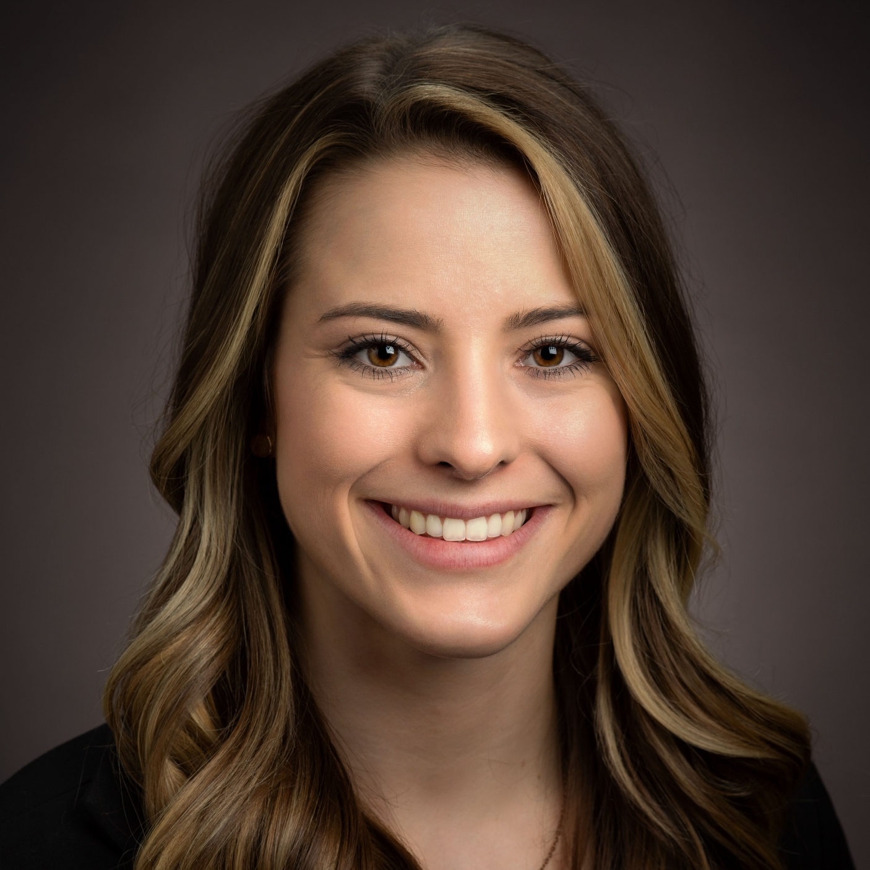
Welcome
Cait Obenauf, MBA
Program Manager, Clinical Informatics, HIMSS

Slide 3
HIMSS Nursing Informatics Community
The Nursing Informatics Community’s purpose is to articulate a cohesive voice for the HIMSS Nursing Informatics community and to provide domain expertise, leadership and guidance to HIMSS activities, initiatives, and collaborations with the global nursing informatics community.
Educational webinars qualified for CA/CPHIMS on nursing informatics topics and emerging trends
www.HIMSS.org/NI
#Nurses4HIT
Notes:
Invite you all to join HIMSS as an individual or through your organization

Slide 4







Join the HIMSS Nursing Informatics Community
Apply for the HIMSS Nursing Informatics Committee
https://www.himss.org/membership-participation/nursing-informatics-community
https://www.himss.org/membership-participation/nursing-informatics-committee
Ways to get involved at HIMSS
as an informatics nurse
Submit a manuscript to the Online Journal of Nursing Informatics
Join the HIMSS Nursing Informatics Education & Networking Task Force
https://www.himss.org/resources/online-journal-nursing-informatics
Reach out to Cait Obenauf at cait.obenauf@himss.org
Attend an upcoming webinar or coffee chat
Get involved with your local HIMSS Chapter
https://www.himss.org/events
https://www.himss.org/membership-participation-chapters

Slide 5
Agenda
Meet the Speakers
Learning Objectives
Fireside Chat
Audience Q&A

Slide 6
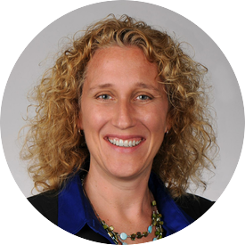
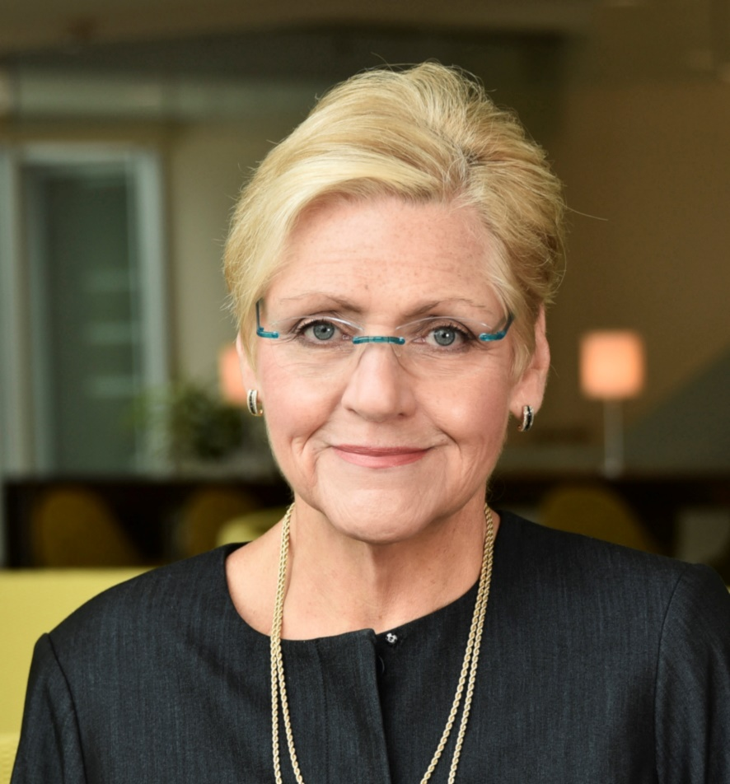
Speakers
Rebecca Freeman, PhD, RN, FAAN, FNAP
Marisa L. Wilson DNSc, MHSc, RN-BC, CPHIMS, FIAHSI, FAMIA, FAAN
Vice President of Health Informatics and IT Operations, University of Vermont Health Network
Associate Professor
Director, Nursing Health Systems Leadership Pathway
Specialty Track Coordinator, MSN Nursing Informatics UAB School of Nursing | The University of Alabama at Birmingham

Slide 7

Learning Objectives
Recognize the internal and external drivers shaping nurses’ roles in the digital evolution of healthcare
Appraise the gaps in the current workforce and among new graduates
Examine the current state of informatics in the novice-to-expert trajectory of the nursing workforce
Assess the adequacy of the preparation pipeline from entry to practice to advance practice

Slide 8
Student to Novice to Expert Pipeline
Pre-Enrollment
Health Professions
Student
Advanced Beginner
Intermediate
Proficient
Expert
Faculty
Facility Educators
Facility Educators
Faculty
Digital Native?
Digital Immigrant?
New graduate
New hire
On going Professional Development
Informatics Super User
Informatics Specialist

Slide 9
Fireside Chat
Introduction to this Series of Four Chats
  Gaps and Potential Solutions in the Academic Sector
  Gaps and Potential Solutions in the Operational Sector
  Summary and Future Plans: Where do we go from here?
Background
  What are competencies?
  What are capabilities?
  Do we have a competency/capability gap in academic preparation?
  Do we have a competency/capability gap in the current workforce?
  What are the tangible results of the gap?
How is the gap occurring if new nurses are “digital natives”?
  The student nurse, new graduate nurse, experienced nurse informatics trajectory: a compounding gap development process.
How is the gap being addressed?
A final plea: This is a big problem that needs many hearts, minds, and hands to solve.

Slide 10


Follow-up Events
Strengthening the Academic Pipeline
Strengthening the Operations Pipeline
Wrap Up, Next Steps, Collaborations

Slide 11
Questions?

Slide 12

Questions? Contact us!
Cait Obenauf, MBA
Program Manager, Clinical Informatics, HIMSS
cait.michicich@himss.org

Slide 13
Thank you for joining!

