Slide 1
Documentation Disconnect is Real: But So Are Solutions
HIMSS Nursing Informatics and Physician Community Webinar
December 8, 2021

Slide 2
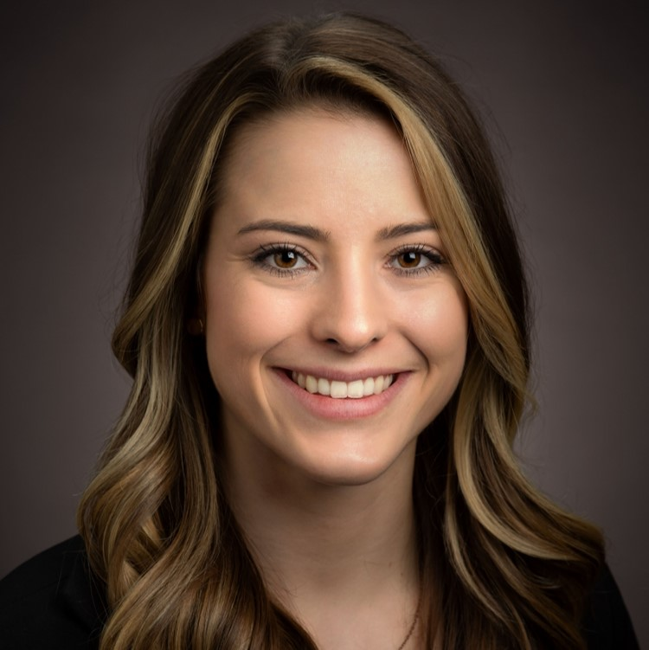
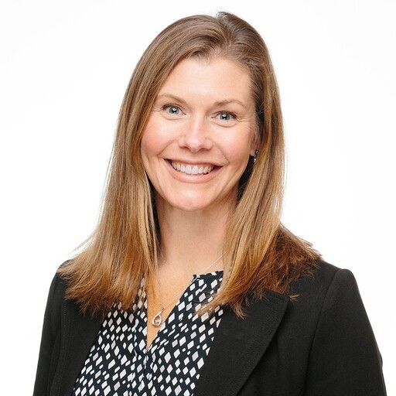
Welcome
Cait Michicich, MBA
Gwynne Jelbaoui
Program Manager, Clinical Informatics, HIMSS
Program Manager, Clinical Informatics, HIMSS
cait.michicich@himss.org
gwynne.jelbaoui@himss.org

Slide 3






Physician Community
HIMSS Physician Community members contribute to advocacy efforts, participate in education offerings, grow their own professional development, access practical tools and participate in networking opportunities
Nursing Informatics Community
Our purpose is to articulate a cohesive voice for the HIMSS Nursing Informatics Community and to provide domain expertise, leadership and guidance to the global nursing informatics community
Thought Leadership
Strategic Partners
Task Forces
Education
Community
Resources

Slide 4

Join us on Accelerate!
Join Accelerate today at YourAccelerate.com
Accelerate is a natural extension of HIMSS's origins and foundation as a member-driven society, and is an innovative solution aimed to support members, partners and the global health ecosystem 365 days a year.
Nurse Informaticists - Register with your email, password, and personal invite code:
MVPNI
Physicians - Register with your email, password, and personal invite code: PHYSCOM
Notes:
ADD THE UNIQUE LINK TO JOIN

Slide 5
Agenda
Learning Objectives
Introduce Moderator
Meet the Speakers
Panel Discussion
Audience Q&A

Slide 6

Learning Objectives
Discuss the requirements from regulatory entities when it comes to patient notes
Gain real time improvement strategies from physicians and nurses in documentation practices
Learn from a patient advocate on how best to document patient records to be consumed in a meaningful way and best practices for patients on how to contribute to their health record

Slide 7
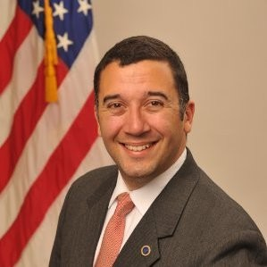
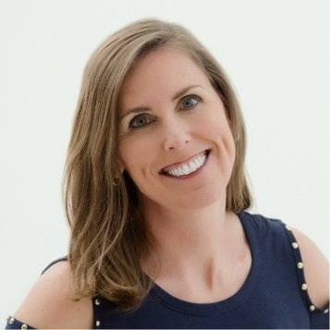
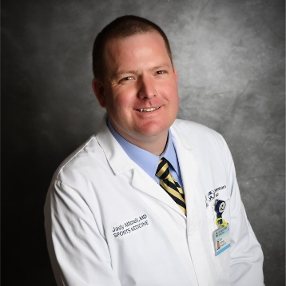
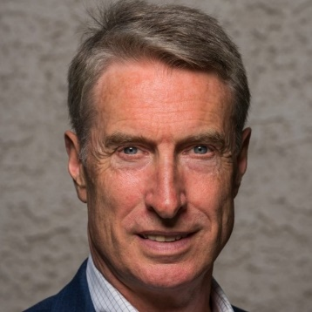
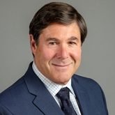
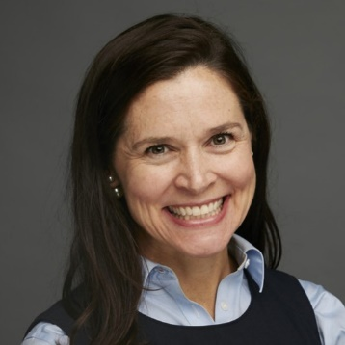
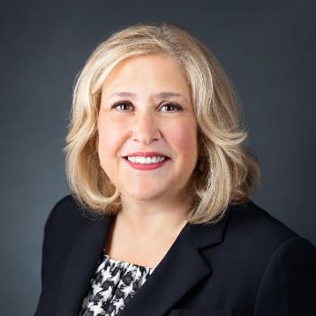
Meet Our Speakers
Thomas Novak
Stacy Hurt, MHA, MBA
Jody Mitchell, MD
Medicaid Interoperability Lead Office of the National Coordinator for Health IT
Healthcare Consultant, Patient Advocate, Digital Health Strategist
Sports Medicine Physician & Medical Director
Owensboro Health
Moderator
Harm Scherpbier, MD, MS
CMIO
HealthShareExchange
Brian Jacobs, MD, FHIMSS
Victoria L. Tiase, PhD, RN-BC, FAMIA, FAAN
Donna Summers, MSN, RN-BC
Professor of Pediatrics, George Washington University, CMIO, eClinicalWorks
Program Director, The Value Institute, New York-Presbyterian Hospital
CNIO, Henry Ford Health System

Slide 8
Panel Discussion

Slide 9
CMS “Patients over Paperwork” initiative
Simplify History and Physical for established patients
Collapse visit levels 2, 3, 4 to just single level – reducing the need for documentation (retain levels 1 and 5)
Flexibility in documentation for levels 2-5 – MDM or time-based
Simplify documentation requirements for:
  immunosuppressive drugs
  home health re-certification
  DME requirements
  ambulance certifications
Consolidate, reduce and simplify Quality Measures
Through 2021 saved $6B and 42 million burden-hours*
* Seema Verma at https://www.kevinmd.com/blog/2020/10/patients-over-paperwork-medicare-has-delivered-lower-costs-and-regulatory-relief-for-health-care-providers.html

Slide 10
Questions?

Slide 11
Questions? Contact us!
Cait Michicich, MBA
Gwynne Jelbaoui
Program Manager, Clinical Informatics, HIMSS
Program Manager, Clinical Informatics, HIMSS
cait.michicich@himss.org
gwynne.jelbaoui@himss.org

Slide 12
Thank you for joining!

