Slide 1
Achieving Smarter Query-Based Exchange Webinar
HIMSS Interoperability & HIE Community
July 22, 2021

Slide 2

HIMSS Interoperability & Health Information Exchange Community
Comprised of nearly 8,000 HIMSS members
Connecting professionals committed to transforming health through standards-based interoperability and health information exchange
A dynamic community for sharing ideas, learning best practices and leveraging collaborative opportunities
https://www.himss.org/membership-participation/communities
Join Today

Slide 3






Thank you to our sponsor

Slide 4
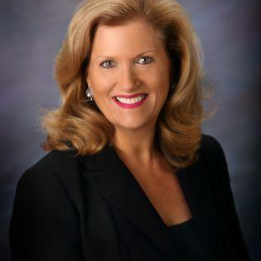


Our Leadership Team
Leslie Kelly Hall
Herman Oosterwijk
Founder, Engaging Patient Strategy
President, OTech

Slide 5


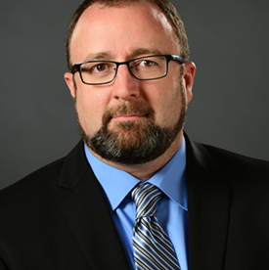
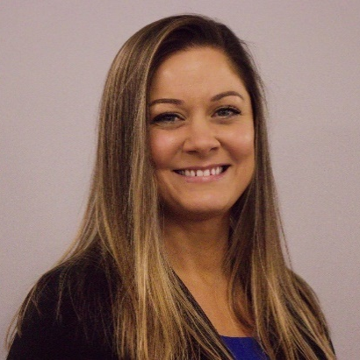
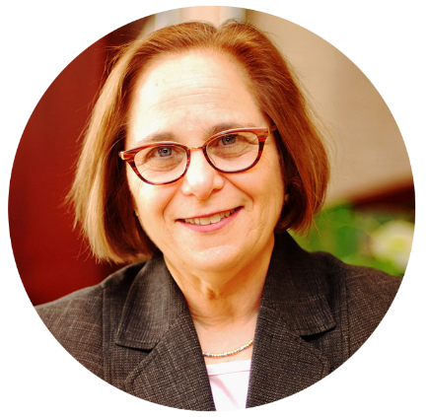
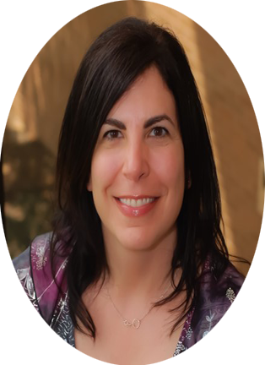
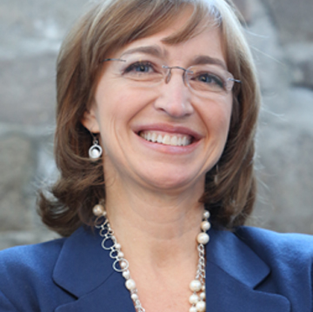
Meet our Speakers
Marilee Benson
Erick Maddox
Candice Titus
Jill Eisenstein
Andrea Richardson
Lisa R. Nelson
President and Cofounder, Zen Healthcare IT
Executive Director, Reliance eHealth Collaborative
Assoc Director of Interoperability, CRISP
Chief Executive Officer,
Rochester RHIO
Chief Information Officer,
Rochester RHIO
VP Business Development, Principal Informaticist,
MaxMD

Slide 6
Learning Objectives
After this Roundtable, attendees should be able to:
  Describe the barriers faced by HIEs in diverse geographic locations to better enable query-based exchange and allow accurate health information to be leveraged at the point of care
  Recognize the needs of the patient in the effort to improve information exchange and discuss how these HIEs can improve patient safety, quality of care and experience
  Discuss how advancements in smarter query-based exchange could impact future versions of the United States Core Data for Interoperability (USCDI)

Slide 7
What is Query-Based Exchange?
Marilee Benson
President & Cofounder, Zen Healthcare IT

Slide 8
What is Query-Based Exchange?
Does an external healthcare organization have additional information about my patient?
  Manual (Clicking on a link) or
  Automated (a query is initiated when a patient record is opened) – SMART!
What healthcare orgs get queried?
  Manual selection in the user interface or
  Automated (by geography or other predetermined factors) – SMART!
What type of data is exchanged and how?
  Clinical Summary Documents (C-CDAs), PDFs
  Primarily using IHE Standards (XCA)
  Emerging - FHIR based exchange - SMART!

Slide 9
Networks supporting Query-Based Exchange
eHealth Exchange
  Provides access to Federal Partners (DOD/VA, Social Security, etc)
  Oldest of the three national networks
  Participants may opt-in to Carequality – SMART!
Commonwell Alliance
  Founded by Cerner; but many other vendors and HIEs now participate
  Built in RLS functionality – SMART!
  Participants may opt-in to Carequality – SMART!
Carequality
  Founded by Epic; but many other vendors and HIEs now participate
  Supports vendors acting as onboarding hubs (Carequality Implementer) (Like Zen!) - SMART!
  Acts as the hub connecting the other two networks together - SMART!

Slide 10
Some Challenges
Huge growth in document sharing across the 3 national networks is exposing some challenges:
  Receiving back ”your own” data; particularly an issue when an HIE is aggregating data in a CDR
  Providers receiving back too much information; that may not be digested properly within the EHR
  Document types returned may be less valuable to some; more valuable to others.
  Finding a ”patient match” and getting data returned.
  Slow adoption of non-treatment use cases, like Patient Queries (PHRs)
All these issues are fixable with SMART approaches.

Slide 11
Reliance & Query-Based Exchange
Erick Maddox
Executive Director, Reliance eHealth Collaborative

Slide 12

About Reliance
Community Based HIE serving Oregon and parts of Washington
Reliance serves the full continuum of care across the region
Patient data in the HIE is robust with both clinical and claims data on ~6M Unique Patients
Perceptions of data sharing in the region made query-based exchange challenging
  The entire region is Epic based
  Our patients really don’t leave our service area
Notes:
Regional Population ~11M
90% of OR population

Slide 13



Reliance & Query Based Exchange
It took the US Military to launch Query
Based Exchange among Reliance HIE participants
Naval Health Clinic Oak Harbor cares for ~20K service members and their dependents in and around Whidbey Island, Washington
Oak Harbor refers med surg, ED and L&D events to four separate local civilian hospitals for their care and treatment
Local hospital facility information about mothers and newborn was hard to obtain in the transition back to the Naval Health Clinic for OB/GYN, primary and pediatric care
Naval Health Clinic started accessing the HIE through the web portal which allowed staff to gauge depth and breadth of patient information available to them through the HIE

Slide 14
Success First… Challenges Later!
Use of Query Based Exchange functionality with local Naval
Health Clinic was virtually challenge free
Not all HIT resources at DoD facilities are centrally managed. Some systems are locally controlled.
Naval Health Clinic Oak Harbor was the highest volume utilizer of query-based access of the HIE through early 2020
Data being accessed by Naval Health Clinic staff evolved from OB Patient encounters, to ED encounter access finally to robust data access driven by community provided care for military personnel and their dependents
As data being accessed evolved so did the method of access from read only portal use to PDF download of patient record, to CCD download of patient record, to an XCA based query through locally controlled application.
By the end of 2020, 8% of documents Oak Harbor retrieved from the HIE were from Reliance participating facilities that were more than 200 miles from the North Sound region of Washington
In 2021 Reliance completed the eHx based connection to the DoD. Oak Harbor staff now query the HIE via eHx and continue to access the Reliance Portal to access information and services not available through eHx query.

Slide 15
Community Adoption Brought Challenges
Success at Oak Harbor demonstrated value to community and query-based access requests increased
EHRs are still learning how to conduct meaningful query-based exchange particularly in the Oral and Behavioral Health Settings
Continued variation in the implementation of standards makes it difficult for query interfaces to be highly replicable
Implementation of HIE query interfaces continues to take place at a community level - each community has slightly different requirements of their query to the HIE.
Each HIT Developer has their own spin on the implementation standards and best practices
Most communities require the ability to filter their own data as well as the data of their “neighbors” was key to the broader community adoption of query-based exchange

Slide 16

Coming Up…
Query Relay
Existing Query-Based users of HIE are increasingly asking for support to relay their query to broader range of networks
Consumer Based Exchange
In partnership with HIE participating health plans Reliance will begin handling consumer queries for clinical data
Cross Sector Exchange
Allowing for queries to and from Community Based Organization systems.

Slide 17
Multiple Document Request & Patient Discovery
Candice Titus
Associate Director of Interoperability, CRISP

Slide 18
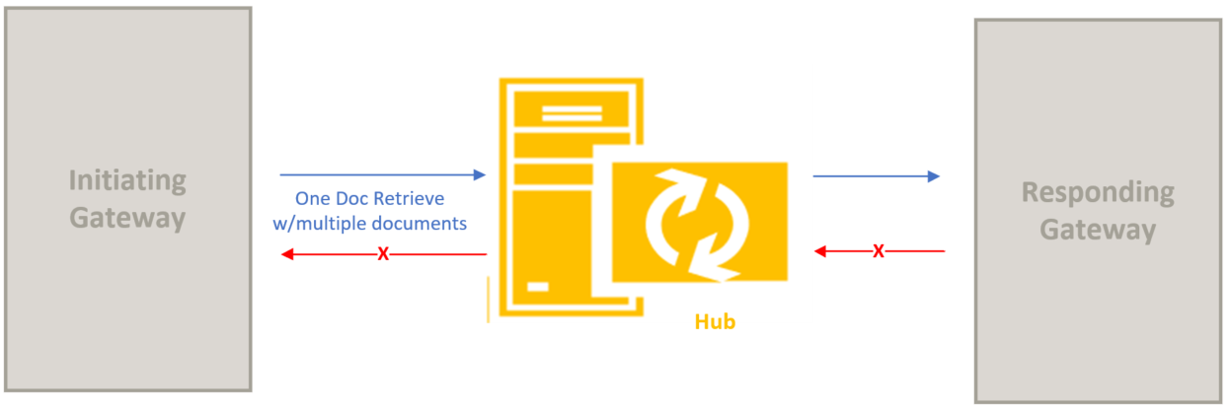
Multiple Document Request (Carequality via eHealth Exchange)
Known Implementors:
CommonWell
Kno2
Redox

Slide 19
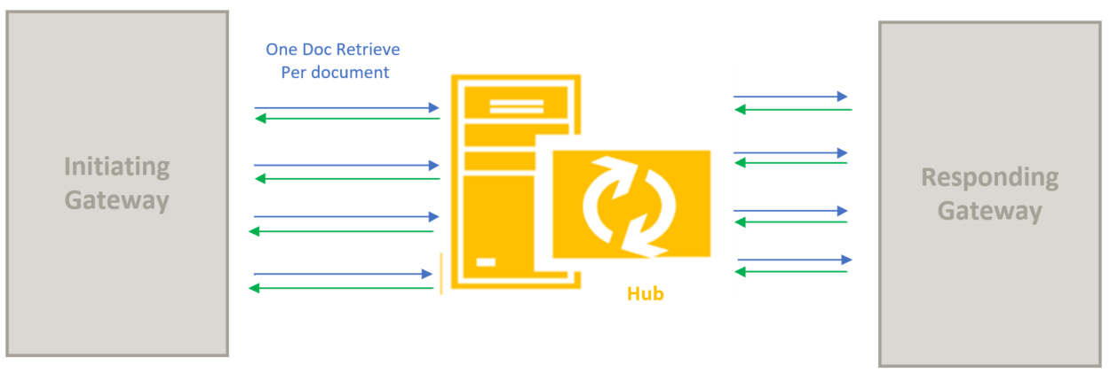
Multiple Document Request (Carequality via eHealth Exchange)
Known Implementors:
CommonWell
Kno2
Redox

Slide 20
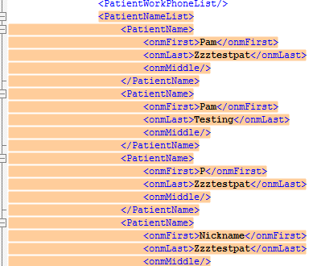
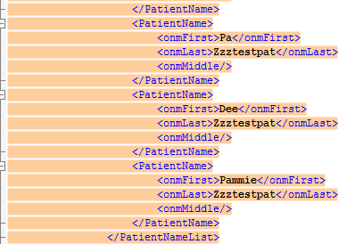
Patient Discovery - Multiple Names (Epic)

Slide 21
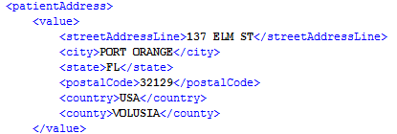
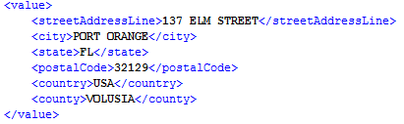
Patient Discovery - Multiple Names (Epic)

Slide 22
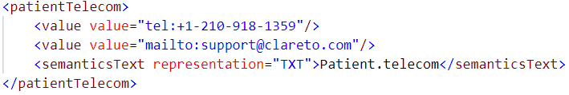
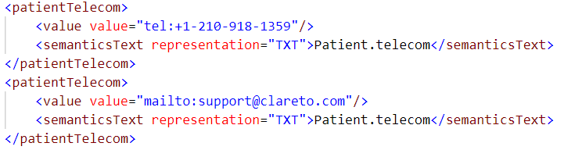
Patient Discovery - Multiple Phone Numbers (ConnectVirginia)
One Telecom Element:
Two Telecom Elements:
22

Slide 23

Patient Discovery - Multiple Phone Numbers (CRISP)
Type Identified:
23

Slide 24
Statewide Health Information Exchange
Jill Eisenstein, Andrea Richardson
CEO and CIO of Rochester RHIO

Slide 25
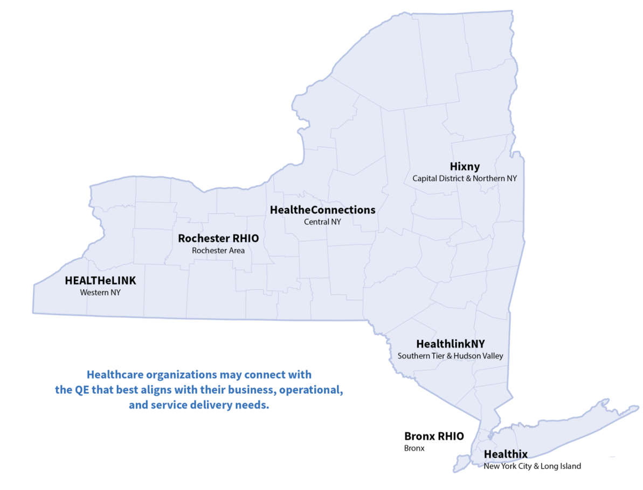

Statewide Health Information Network of New York (SHIN-NY)
Rochester RHIO is 1 of 6 regional Qualified Entities (QEs) in New York State that make up the SHIN-NY.
Rochester RHIO serves 1.5 million residents in 14 counties in the greater Finger Lakes Region of NYS.
Rochester RHIO has over 1,000 practices that contribute data, including 300 community-based organizations.
More: https://www.nyehealth.org/shin-ny/what-is-the-shin-ny/

Slide 26
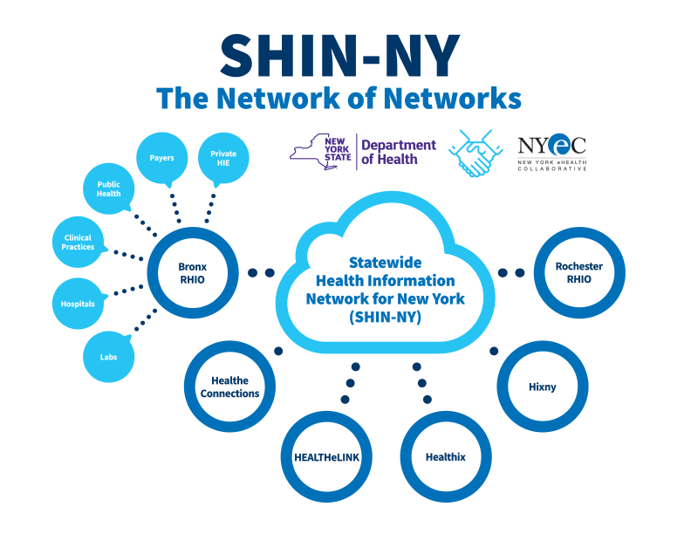


Slide 27
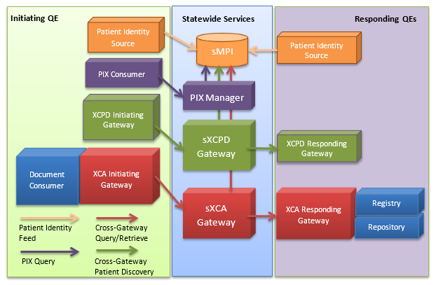
sPRL Architecture

Slide 28
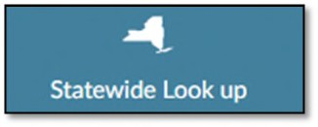
Statewide Patient Record Lookup (SPRL)
Statewide Lookup allows users to search data across New York State.
If a patient has been seen for clinical services in another part of New York, for example, Buffalo or NYC, then the queried results will pull from the appropriate QE and display in the Rochester RHIO patient record.
Once available, successful queried results display and authorized users can download a CCD of the information.

Slide 29
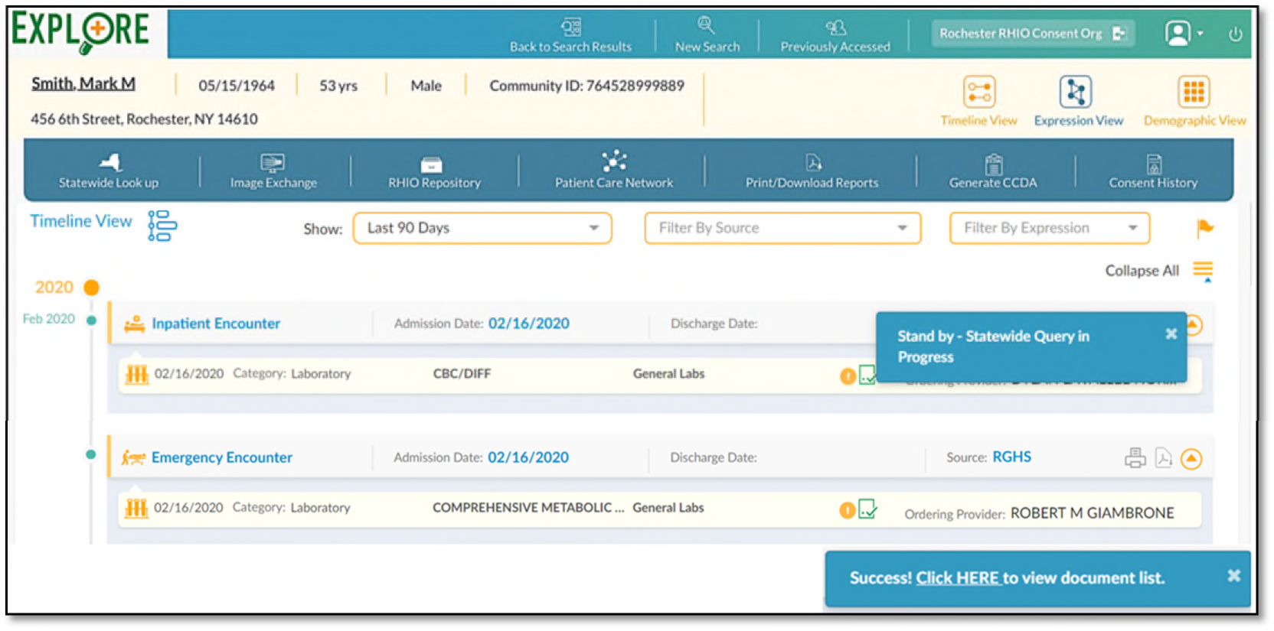

Slide 30
Patient Advocate Perspective
Lisa R. Nelson, MS, MBA
VP Business Development, Principal Informaticist,
MaxMD

Slide 31

Patient Advocate Perspective
The vision for health information exchange for patients: Past, Present, Future
How can smarter query-based exchange improve patient experience?
What needs to be “fixed” or accomplished anew?

Slide 32


Evolution of a patient’s role in patient-centered HIE
Past
Opt-in (or simply don’t Opt- out) of health information exchange.
Providers can get the information they need to care for you.

Slide 33

Evolution of a patient’s role in patient-centered HIE
Past
Present
Opt-in (or simply don’t Opt- out) of health information exchange.
Providers can get the information they need to care for you.
Standardized patient access APIs give patients access to clinical data and documents.
You can get your own data, then share it with whom you please.

Slide 34

Evolution of a patient’s role in patient-centered HIE
Past
Present
Future
Opt-in (or simply don’t Opt- out) of health information exchange.
Providers can get the information they need to care for you.
Standardized patient access APIs give patients access to clinical data and documents.
You can get your own data, then share it with whom you please.
Information exchange supports bi-directional communication of data and documents for patients and caregivers.
You can initiate a request for your information, report errors in the records you receive, request corrections, and report your health outcomes.

Slide 35

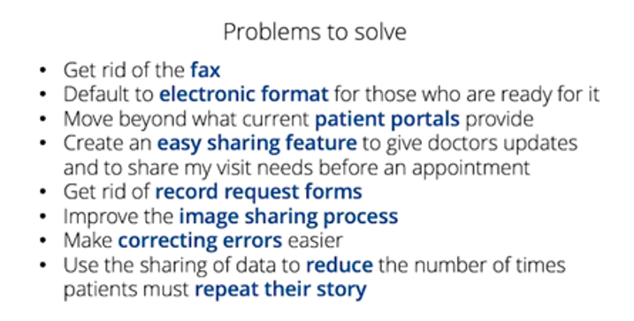
DirectTrust Summit – Live Webinar
June 10, 2021
Morgan Gleason
How can smarter query-based exchange improve patient experience?
    Make it more convenient for patients to get the information they want, the way they want to get it, using the technology they want.
    Make easier for patients to access their information with APIs at HIEs, where data is aggregated already.
    The way patients query for their information needs to be simplified. Make the process work the same way everywhere.
    Ask patients and caregivers what they need. Develop technology based on patient-provided use cases. Serve information the way patients want to consumer it.

Slide 36

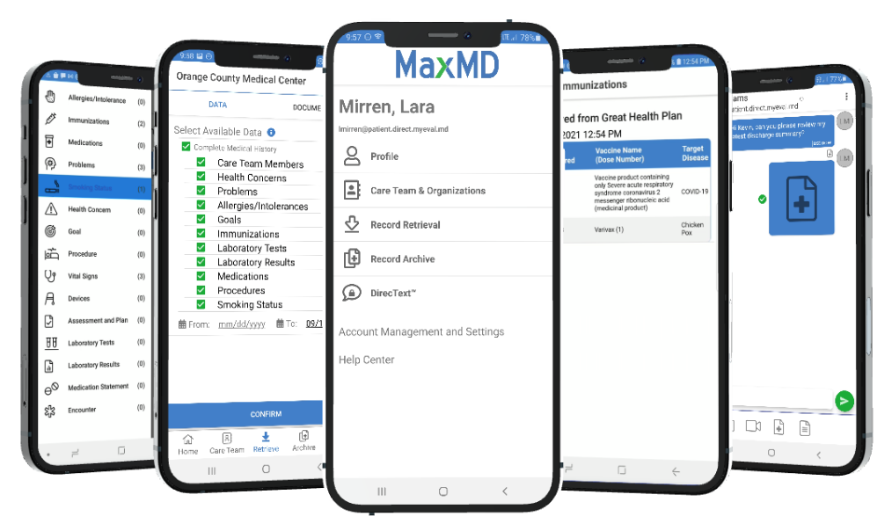
What needs to be “fixed” or accomplished anew to make evolution for patient access possible?
1. Rapidly address app registration issues.
Avoid consumer disappointment.
Reduce burden on EHRs and App vendors.
Accelerate the App Ecosystem at scale.
Notes:
Interoperability occurs at the speed of trust

Slide 37
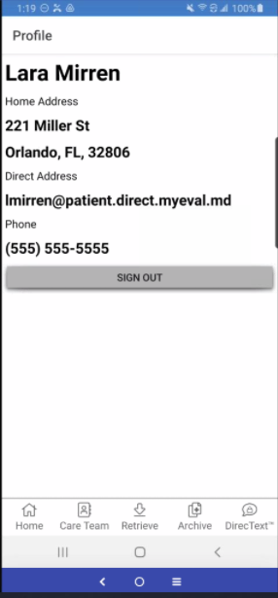
What needs to be “fixed” or accomplished anew to make evolution for patient access possible?
2. Support provisioning of Consumer Credentials.
Provide trusted identities for patients and caregivers.
Clarify requirements to meet identity requirements that prevent information blocking.
Improve patient matching.
Leverage existing proven technology and identity proofing policies – and facilitate bidirectional. communication by using Direct for consumers.
Notes:
Interoperability occurs at the speed of trust

Slide 38
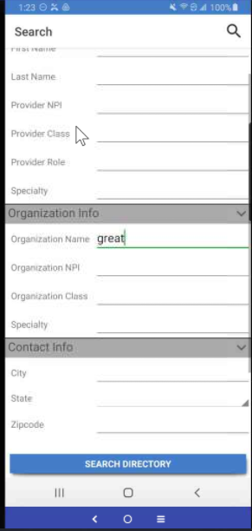
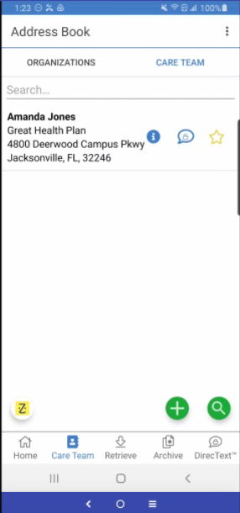
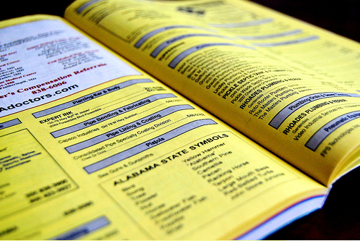
What needs to be “fixed” or accomplished anew to make evolution for patient access possible?
3. Offer Directory Services that enable patients to find digital endpoints that support the data access they need.
Modernize
Notes:
Interoperability occurs at the speed of trust

Slide 39

What needs to be “fixed” or accomplished anew to make evolution for patient access possible?
4. Accelerate creation of new digital HIM department workflow policies and practices.
Notes:
Interoperability occurs at the speed of trust

Slide 40

What needs to be “fixed” or accomplished anew to make evolution for patient access possible?
4. Accelerate creation of new digital HIM department workflow policies and practices.
Create transparent, common, release of information workflows.
Reduce the burden for supporting consent-based digital workflows with digital automation.
  For the caregiver use case.
  Not just the patient access use case.
Require support for a standard Medical Records Correction Request workflow.
Notes:
Interoperability occurs at the speed of trust

Slide 41
Audience Q&A
Marilee Benson
Erick Maddox
Candice Titus
Jill Eisenstein
Andrea Richardson
Lisa R. Nelson
President and Cofounder, Zen Healthcare IT
Executive Director, Reliance eHealth Collaborative
Assoc Director of Interoperability, CRISP
Chief Executive Officer,
Rochester RHIO
Chief Information Officer,
Rochester RHIO
VP Business Development, Principal Informaticist,
MaxMD

Slide 42

Thank you!
Contact email:
Interoperability & HIE Community interop@himss.org

